Slide 1



An extremely brief introduction to Bayesian Markov chain Monte Carlo
Matt Denwood
md@sund.ku.dk
Department of Veterinary and Animal Sciences
University of Copenhagen
Denmark

Slide 2
Overview
What is Bayesian statistics?
What is the theory behind MCMC?
How does MCMC work in practice?
A basic example: prevalence estimation

Slide 3
What is Bayesian statistics?

Slide 4
Classical/frequentist statistics
Concerned with the long-run probability of future events
If I repeat this experiment lots of times with a known parameter value, what will happen?
CI should be interpreted as reflecting future samples
Remember the definition of a likelihood:
Probability of the data given the parameters
e.g. sensitivity/specificity of a test given a known true disease state
But isn’t this backwards? Wouldn’t we rather know the probability of the parameters given the data?

Slide 5
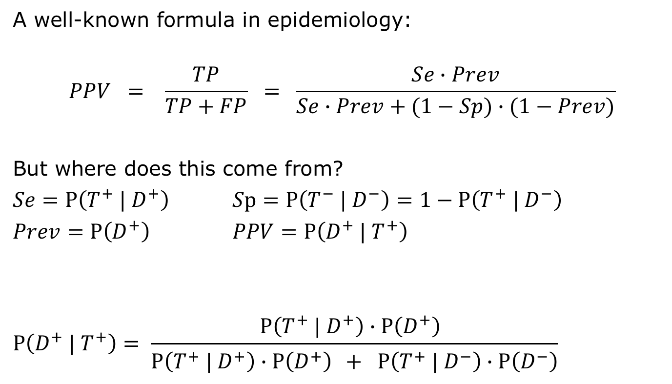
An example using diagnostic tests
A well-known formula in epidemiology:
$$PPV = \frac{TP}{TP+FP} = \frac{Se∙Prev}{Se∙Prev+(1−Sp)∙(1−Prev)}$$
But where does this come from?
$Se=P\left(T^{+} | D^{+}\right)$ $Sp=P\left(T^{−} | D^{−}\right)=1−P\left(T^{+} | D^{−}\right)$
$Prev=P\left(D^{+}\right)$ $PPV=P\left(D^{+} | T^{+}\right)$
$$P\left(D^{+} | T^{+}\right)= \frac{P\left(T^{+} | D^{+}\right)∙P\left(D^{+}\right) }{P\left(T^{+} | D^{+}\right)∙P\left(D^{+}\right) + P\left(T^{+} | D^{−}\right)∙P\left(D^{−}\right)}$$
Likelihood
Prior information
Posterior information

Slide 6
Bayes theorem
Discrete form:
Continuous form:
General form:
Posterior Likelihood x Prior

Slide 7
Bayesian statistics
”Belief” is expressed as a probability distribution
i.e. We don’t know exactly what the parameter value is, but we can quantify our uncertainty
This is the key difference to frequentist statistics
We usually have continuous probability distributions for both prior and posterior:
+
=
What we knew before
What the data tell us
What we know now

Slide 8
What is the theory behind MCMC?

Slide 9
MCMC: the theory
First define a function to calculate a posterior probability corresponding to a Binomial likelihood and Beta prior:
log_posterior_fun <- function(parameter){
... See the exercise if you are interested in R code ...
}
Then choose a ‘reasonable’ place to start looking for our parameter values, and calculate the posterior at that parameter value:
parameter[1] <- 0.25
log_post[1] <- log_posterior_fun(parameter[1])
log_post[1]
-27.5222

Slide 10
MCMC: the theory
Now sample another parameter value using a random walk:
new_par <- rnorm(1, mean=parameter[1], sd=sigma)
0.2606076
new_lpost <- log_posterior_fun(new_par)
-18.00832
That’s a bit better! Let’s store this new value:
parameter[2] <- new_par
log_post[2] <- new_lpost
And resample:
new_par <- rnorm(1, mean=parameter[1], sd=sigma)
0.2572526
new_lpost <- log_posterior_fun(new_par)
-20.72975

Slide 11
MCMC: the theory
This is a bit worse. Should we keep it or not?
We will let fate decide … but it makes sense to have a higher chance of accepting the new parameter value if it is not much worse than the old value:
probability_ratio <- exp(new_lpost – log_post[2])
0.06578108
accept <- rbinom(1, 1, probability_ratio)
0
So we reject this new value, and keep the old one
We also reward the old parameter for being hard to beat by counting it twice (so this counts as the 2nd and 3rd values in the chain)
parameter[3] <- parameter[2]
log_post[3] <- log_post[2]

Slide 12
MCMC: the theory
Repeat for the rest of the 1000 iterations, then look at the results:
plot(parameter, type='l')

Slide 13
Markov chain Monte Carlo
This algorithm is a basic implementation of MCMC!
MCMC is used to approximate a posterior distribution by sampling from it
Dependence on previous value is critical
Consecutive samples are not independent
Eventually a Markov chain will forget where it started, but it might take a while before it does this
This non-randomness of Markov chains has 2 important consequences:
The starting values are not immediately forgotten
We need a burn-in period before sampling from the chains (aka identifying convergence on the stationary distribution)
A sample of 1000 auto-correlated iterations gives us less information than a sample of 1000 independent iterations
We need to know the effective sample size

Slide 14
1. Burn-in
It is ESSENTIAL to identify and remove the burn-in period
plot(parameter, type='l')

Slide 15
1. Burn-in
It is ESSENTIAL to identify and remove the burn-in period
plot(parameter, type='l')

Slide 16
2. Effective sample size
An effective sample size of 137 – not a good approximation

Slide 17
2. Effective sample size
An effective sample size of 1752 – a pretty good approximation

Slide 18
2. Effective sample size
An effective sample size of 16759 – a very good approximation

Slide 19
Dangers of MCMC
1. Problems related to the Markov chain
We didn’t remove enough burn-in iterations so our posterior is skewed by the parameter space from where we happened to start the initial values
Our chain hasn’t really found the stationary posterior, and is just sampling from a local solution
CONVERGENCE
2. Problems related to the Monte Carlo integration
We didn’t take enough samples to adequately represent the true posterior
EFFECTIVE SAMPLE SIZE

Slide 20
How does MCMC work in practice?

Slide 21
Using BUGS
Bayesian (analysis) Using Gibbs Sampling
Generic MCMC framework with ready-made algorithms!
Advantages
Easy to use, fast for most problems
Almost as flexible as writing your own algorithm
Disadvantages
Hides many of the problems with MCMC sampling
Does not cure any of the problems with MCMC sampling
A BUGS model is compiled by the software
The model statements are converted into an MCMC sampler (written in an underlying language e.g. C++)
The order that statements are written in the model doesn’t matter
All variables in the model must be defined EXACTLY once
NB: it is a symbolic language NOT a programming language

Slide 22
Available Software
OpenBUGS
Available for Windows, Linux and Mac (under emulation)
No longer under active development
Can be called from R
JAGS (Just Another Gibbs Sampler)
Technically not BUGS, but almost identical
Better cross platform support than BUGS
Primarily designed to be called from within R
rjags, runjags, R2jags, jagsUI
JAGS models are identical, just the R code changes
Stan
Uses Hamiltonian Monte Carlo rather than MCMC, but similar
Often faster than JAGS for difficult problems
Slower than JAGS for easier problems

Slide 23
Procedure
Define a syntactically valid model (used to calculate the posterior)
Decide which variables to monitor
Supply data and initial values (optional)
Call the external software (BUGS, JAGS or Stan)
Make sure the chains have converged
Gelman-Rubin statistic compares the variance within chains to the variance between chains – ratio < 1.05 indicates that chains are sampling the same values so have probably converged
But always check the trace plots visually as well!
Make sure the number of sampled iterations is high enough
An effective sample size of >1000 for parameters of interest is OK

Slide 24
Visual assessment of convergence
Have these two chains (pink and blue) converged?
Looks good
[We are OK to look at the model results]

Slide 25
Visual assessment of convergence
Have these two chains (pink and blue) converged?
Looks bad
[Model results cannot be used]

Slide 26
A basic example: prevalence estimation

Slide 27
JAGS: Define and run the model
Define the model, load the runjags library, and define the data in R:
bugs_model <- "
model{
Positives ~ dbin(apparent_prevalence, TotalTested)
apparent_prevalence ~ dbeta(1,1)
#monitor# apparent_prevalence
#data# Positives, TotalTested
}
"
library('runjags')
Positives <- 1210
TotalTested <- 4072
results <- run.jags(bugs_model, n.chains=2, burnin=5000, sample=10000)

Slide 28
JAGS: Check convergence
plot(results)

Slide 29
JAGS: Check sample size and results
> results
JAGS model summary statistics from 20000 samples (chains = 2; adapt+burnin = 6000):
Lower95 Median Upper95 Mean SD Mode
apparent_prevalence 0.28339 0.29719 0.31155 0.2972 0.0071436 --
MCerr MC%ofSD SSeff AC.10 psrf
apparent_prevalence 0.000063509 0.9 12652 0.018843 1.0002
Total time taken: 0.8 seconds
# See also:
?runjags

